Slide 1

Welcome to the World of iMatrix
iMatrix World Wide

Slide 2
iMatrix World Wide has interests in Ten Business verticals. Major amongst these are: 1. Education 2. International Cultural & Educational Tours 3. Builders & Developers 4. Hotels 5. Foodtech

Slide 3
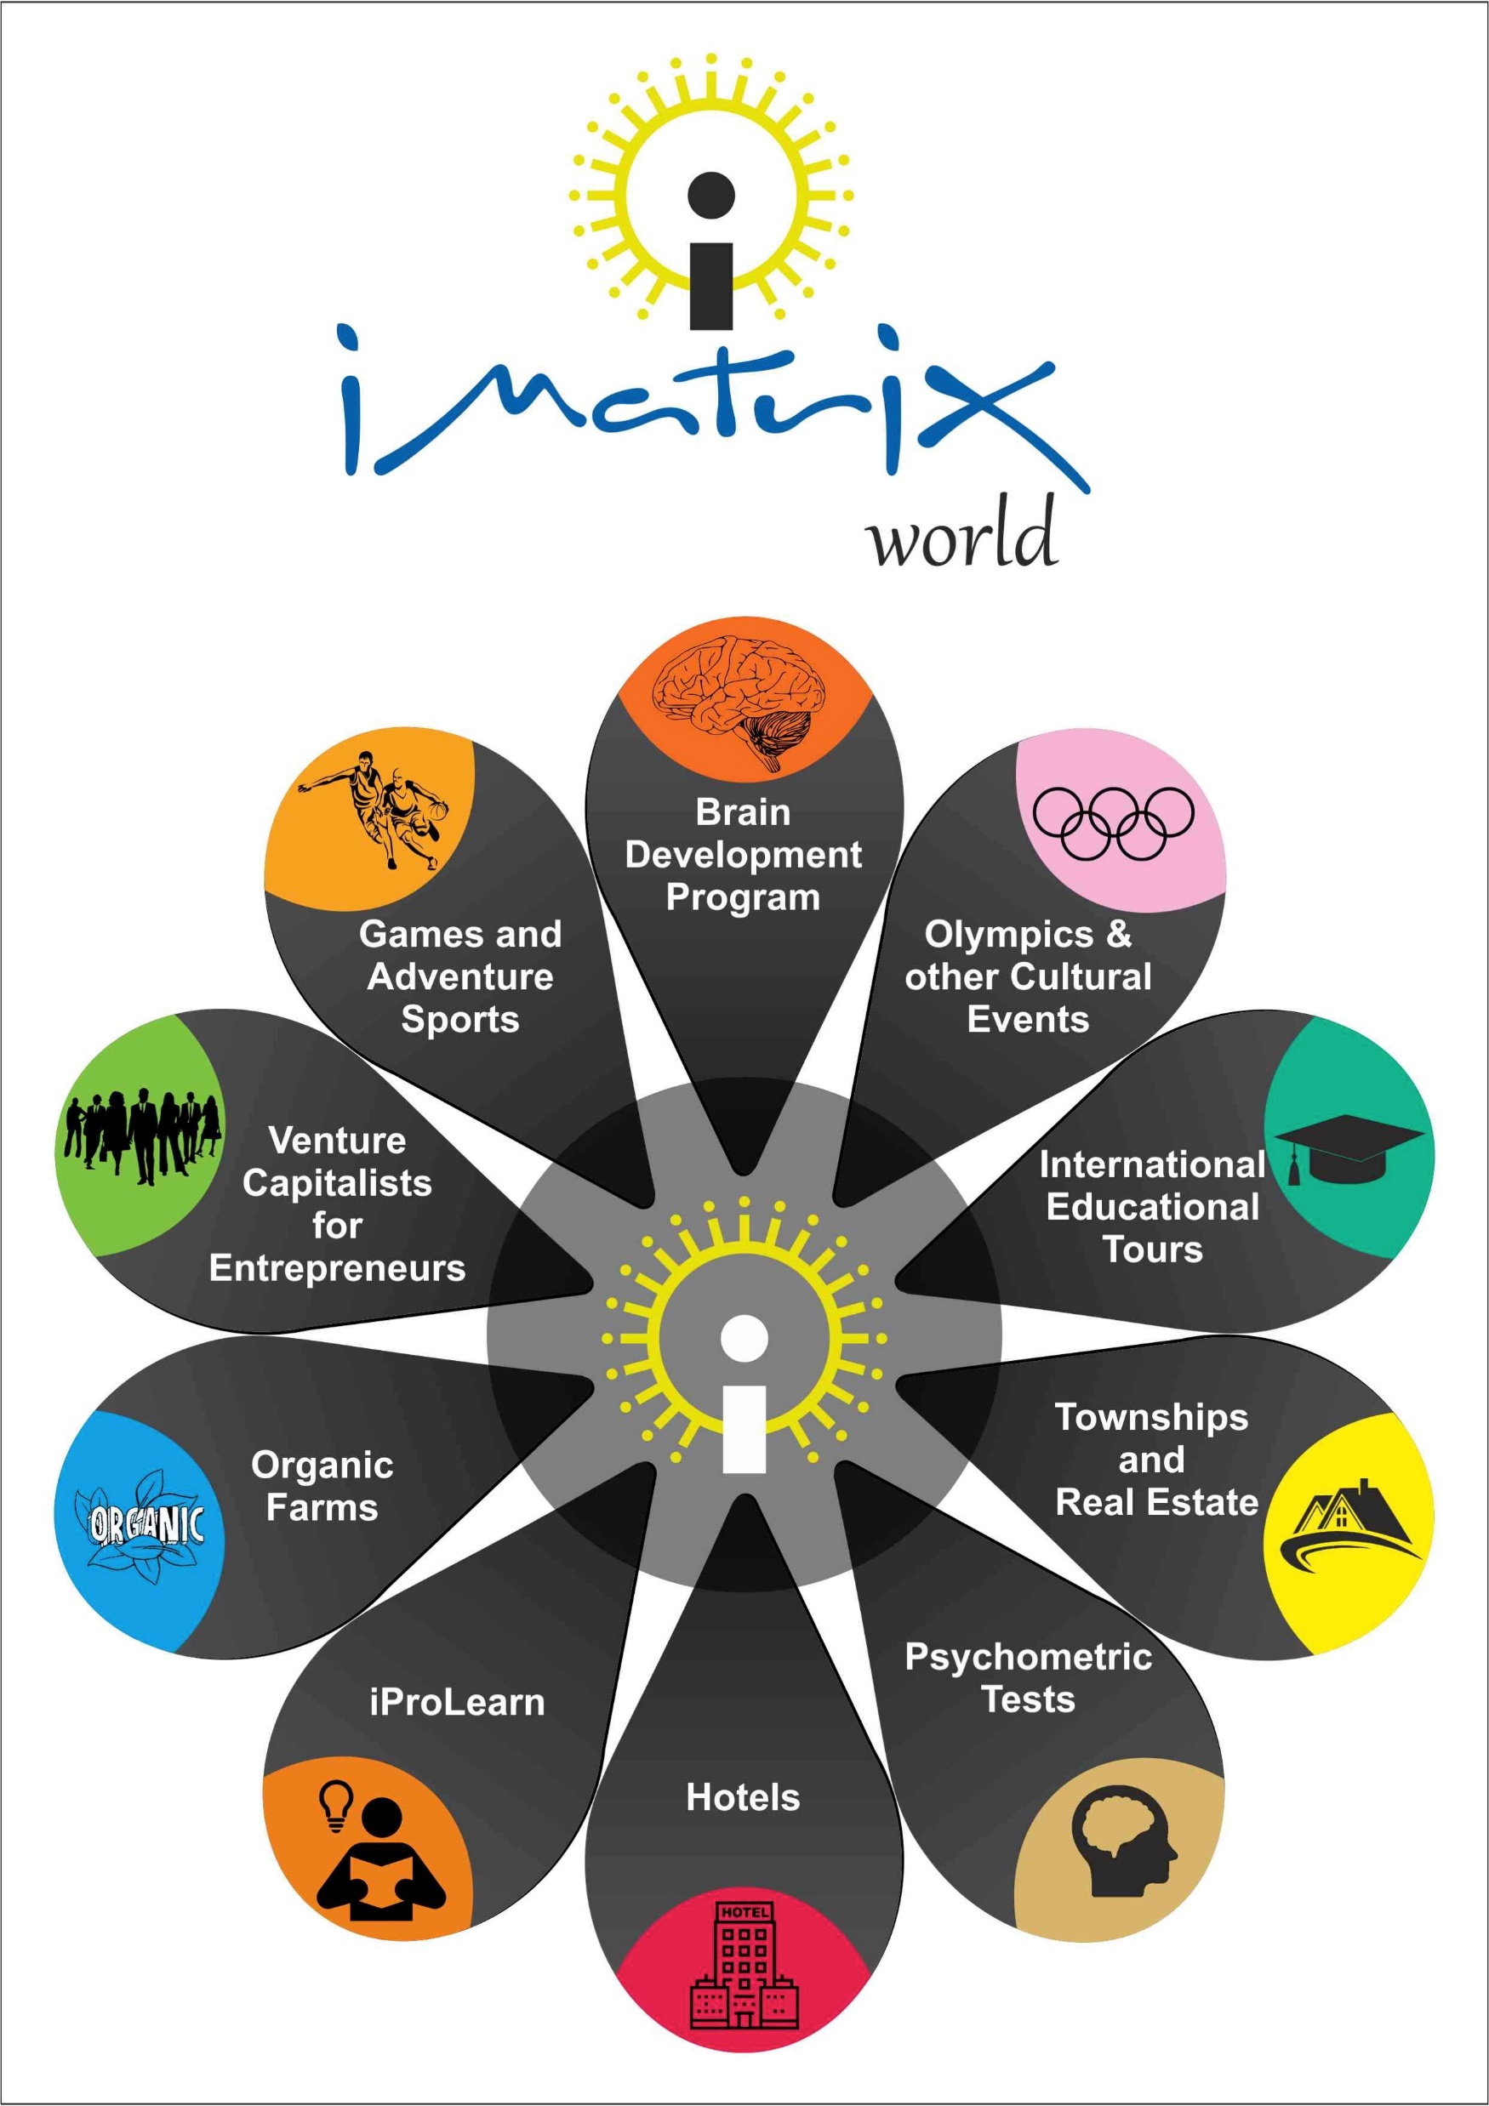

Slide 4
We have our Direct and Franchise Operations in: All States of India We have strong Business Associates in: UK, Canada, USA, Australia, New Zealand, Indonesia & Dubai

Slide 5
Our Corporate Office
iMatrix World Wide
CDCL Bhawan, Plot 5
Madhya Marg, Sector 28 B
Chandigarh, India - 160026

Slide 6
iMatrix was founded by Dr Rohit Shekhar Sharma on September 27, 2005, a day which is fondly celebrated as Founder’s Day at iMatrix. All the Business Verticals are professionally managed by competent Teams headed by their respective Chief Operating Officers.

Slide 7
1. EDUCATION We began as a Brain Development Education organization teaching ABACUS, Vedic Maths, Neurobics, Super Memory Booster and Examination Skills to students. We have taught more than 200000 students so far in India and other countries. We have a strong Franchise Network in India spread across all States and Metropolitan cities. Details of this business are on www.imatrixworldwide.com

Slide 8
Known as Memory Master and Career Guru, Dr Rohit Sharma is a Brain Development Expert. He has authored 19 books on Brain Development.

Slide 9
More than 200 of our students are in Limca and India Book of records for their extraordinary brain power. Our students have been awarded by the Hon’ble President of India, the Prime Minister of India, Amitabh Bachhan, Shabana Azmi and many Governors and Chief Ministers.

Slide 10
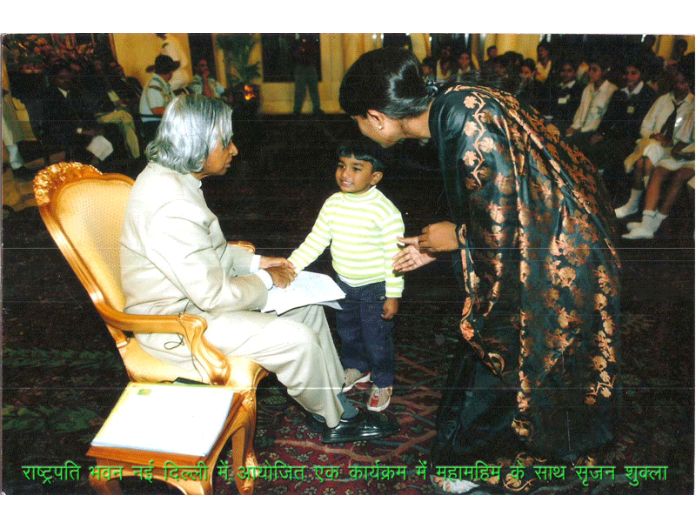

Slide 11
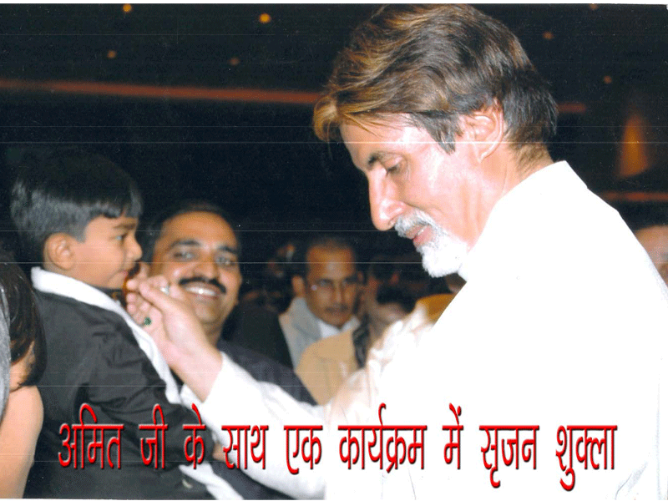

Slide 12
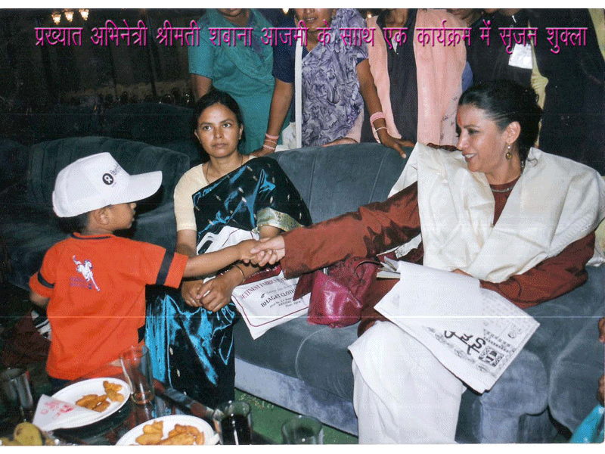

Slide 13
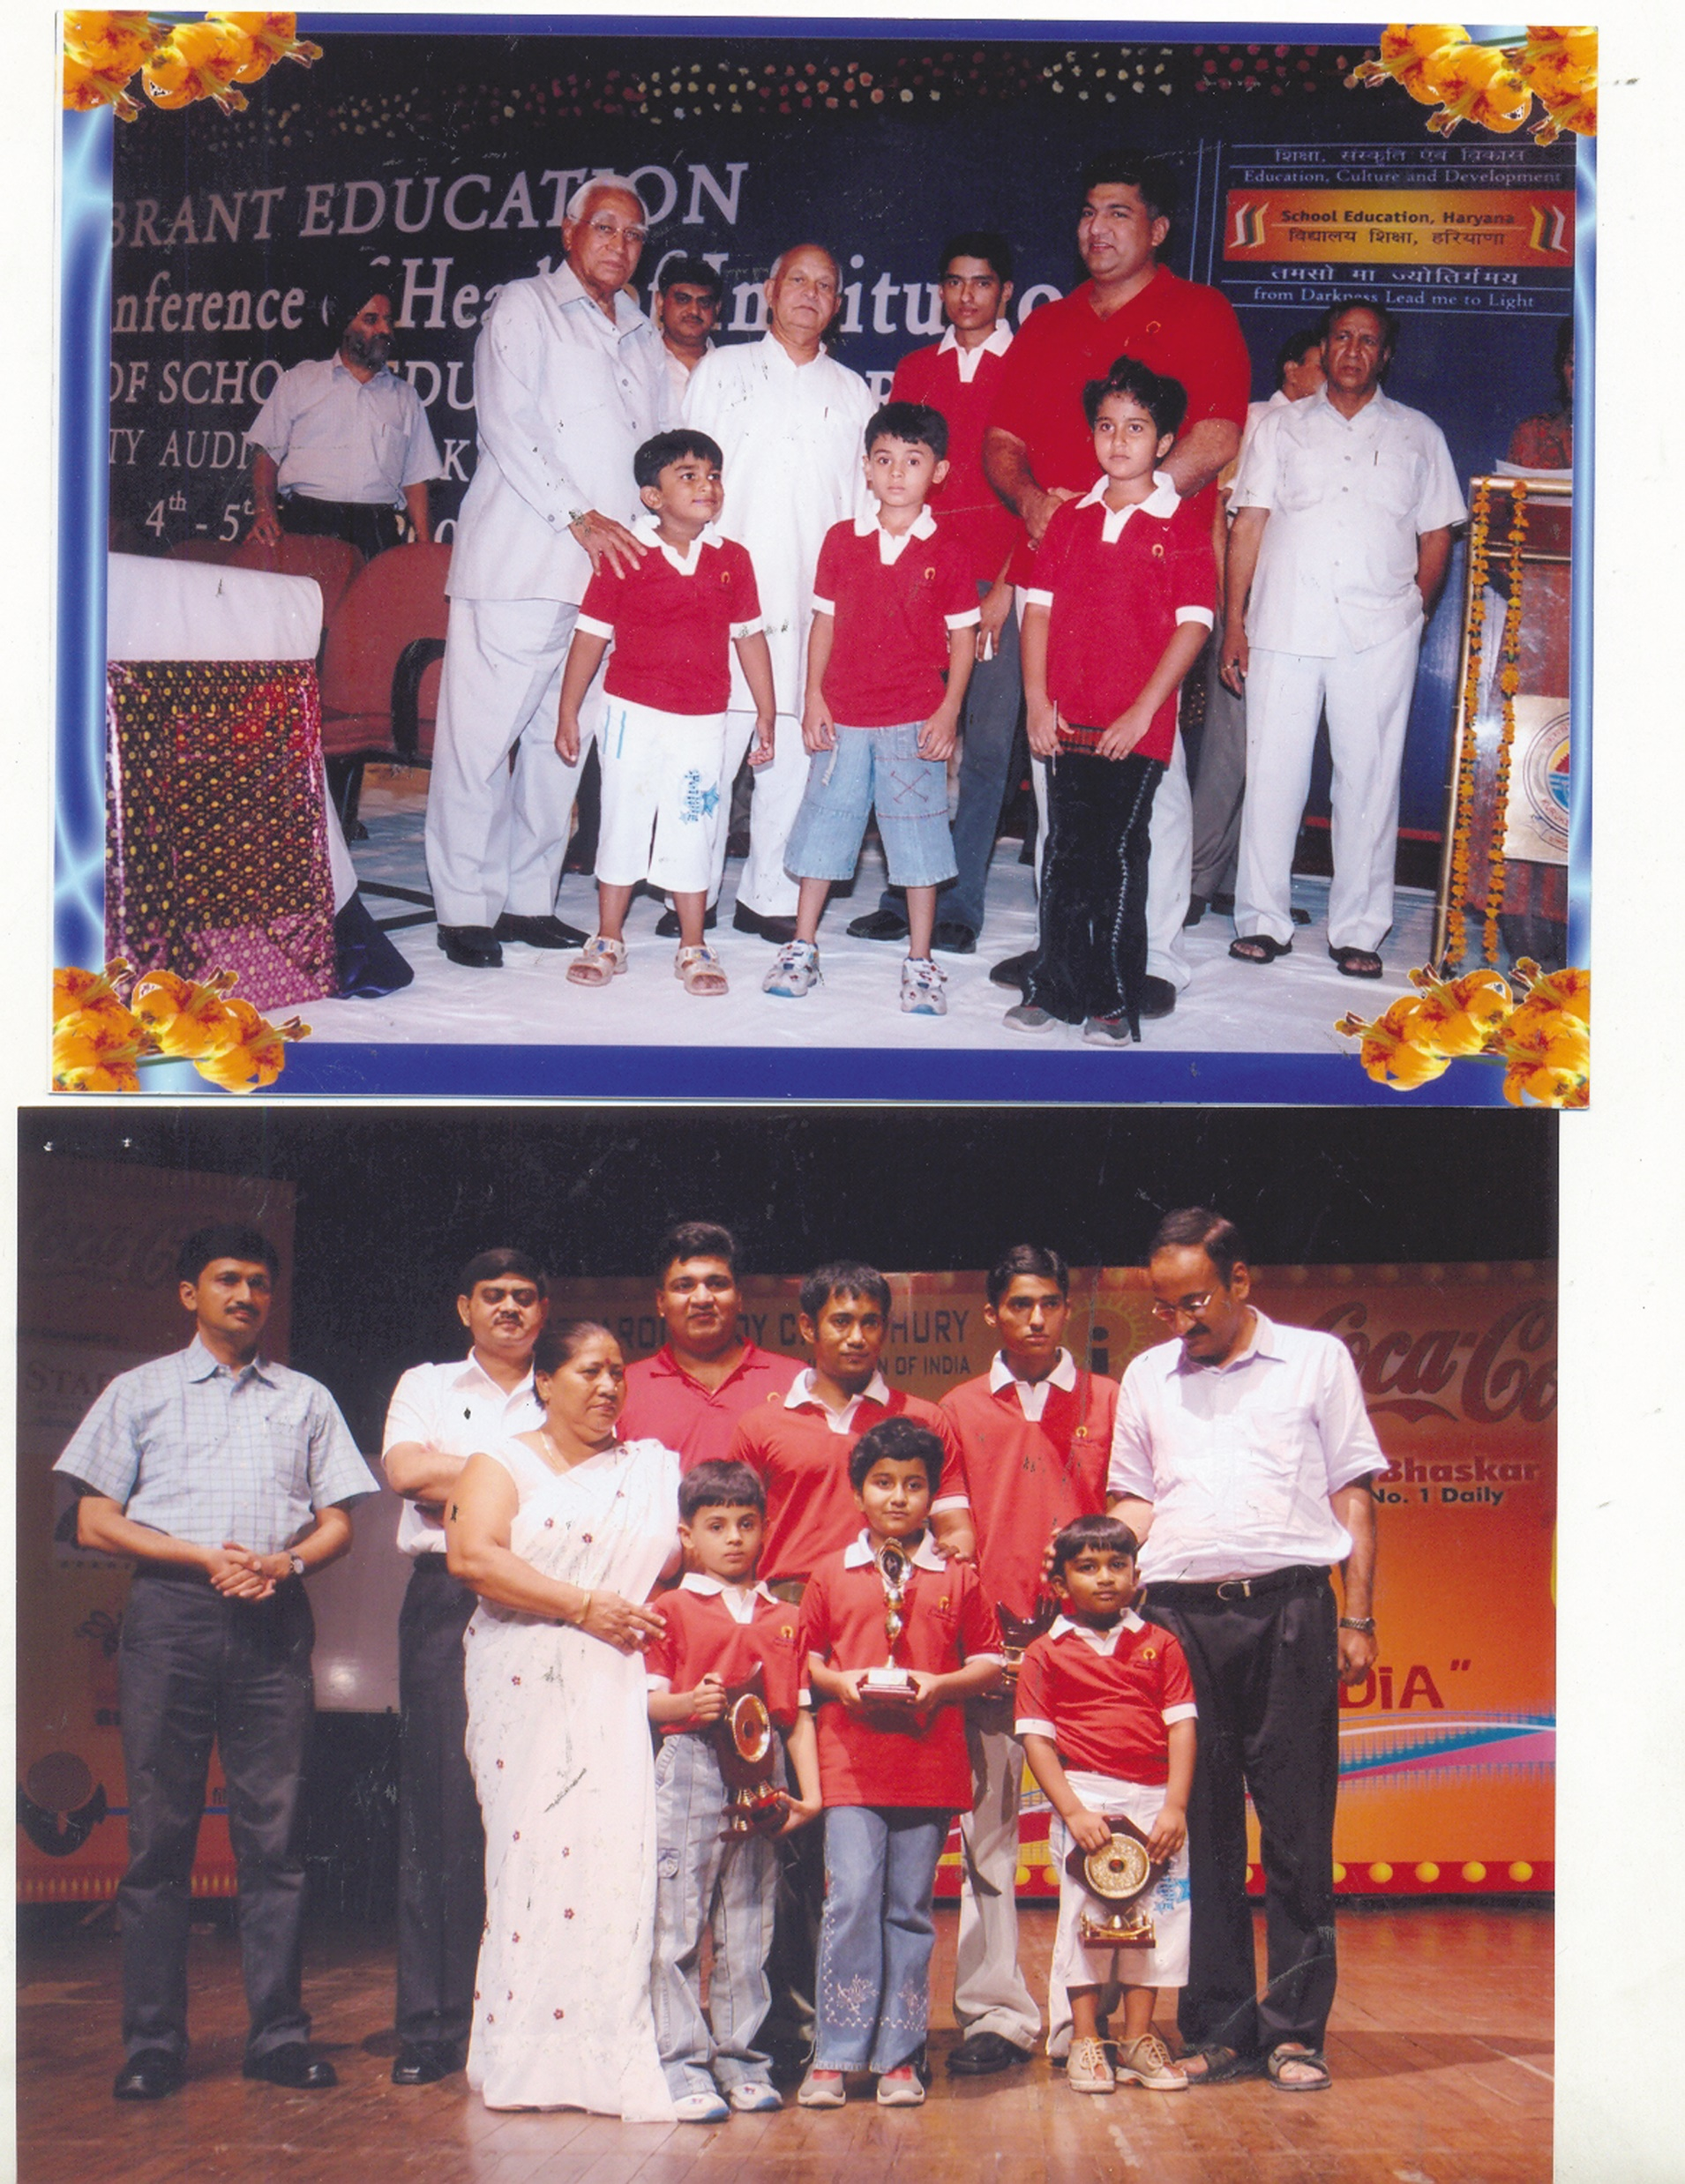
Education International Tours Builders & Developers

Slide 14
2. INTERNATIONAL TOURS We specialize in educational and cultural tours for students. We take students from India and Bangladesh on various International Edutours to Countries like UK, Canada and USA. We have organized nearly 150 tours for more than 5000 students. Details of this business are on www.worldspacetours.com

Slide 15

Official Official Team India
Cultural at London Olympics, 2012

Slide 16
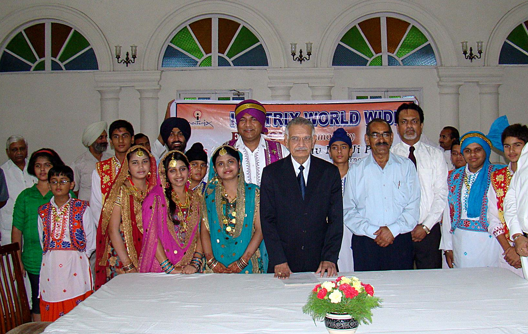
Hon’ble Governor Sh Shivraj Patil flagging off iMatrix Team India Cultural
Hon’ble Governor, Punjab flags us off for London Olympics

Slide 17
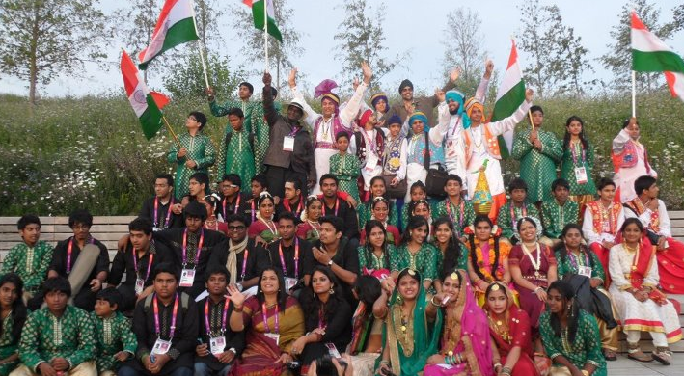
iMatrix Team India Cultural at London Olympics, 2012
iMatrixians at London Olympics, 2012

Slide 18
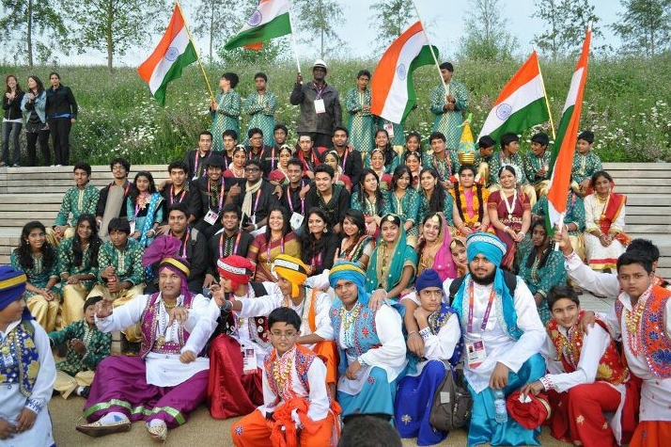
EXPLORE THE SPACE… EXPOLRE YOURSELF…
iMatrix – Making India proud!

Slide 19



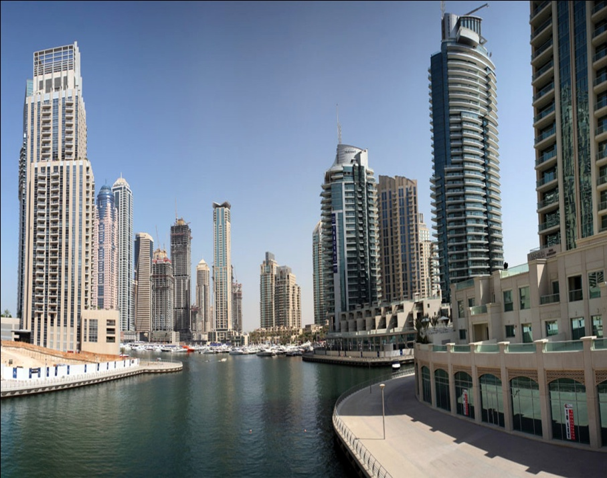
3. BUILDERS & DEVELOPERS

Slide 20
As Builders and Developers
we have constructed more than 120 Mega Projects including Universities and Hospitals.
Apart from the Construction business, we have developed our own Townships in Mohali, Peermuchhalla and Kasauli.
Please visit our township THE TAJ TOWERS on www.tajtowers.com

Slide 21
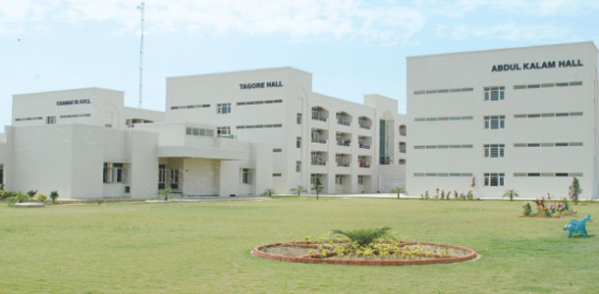
Completed Projects
RAJIV GANDHI NATIONAL UNIVERSITY OF LAW

Slide 22
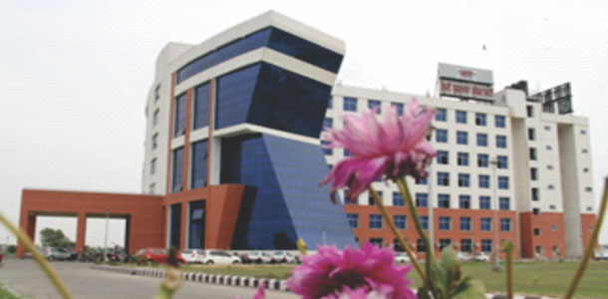
Completed Projects
SHRI GURU GRANTH SAHIB WORLD UNIVERSITY

Slide 23
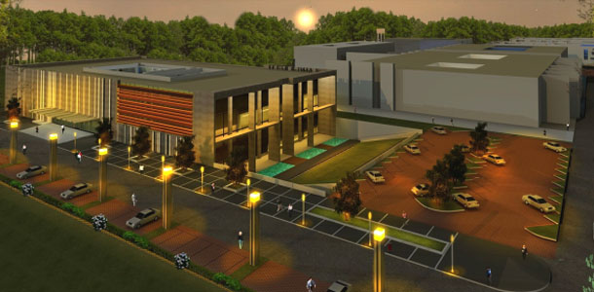
Completed Projects
THAPAR UNIVERSITY CAMPUS, DERABASSI

Slide 24
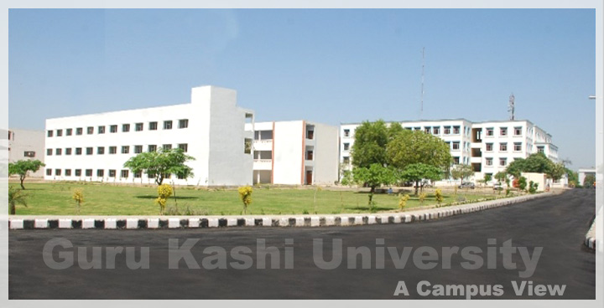
Completed Projects
GURU KASHI UNIVERSITY, TALWANDI SABO

Slide 25


Slide 26
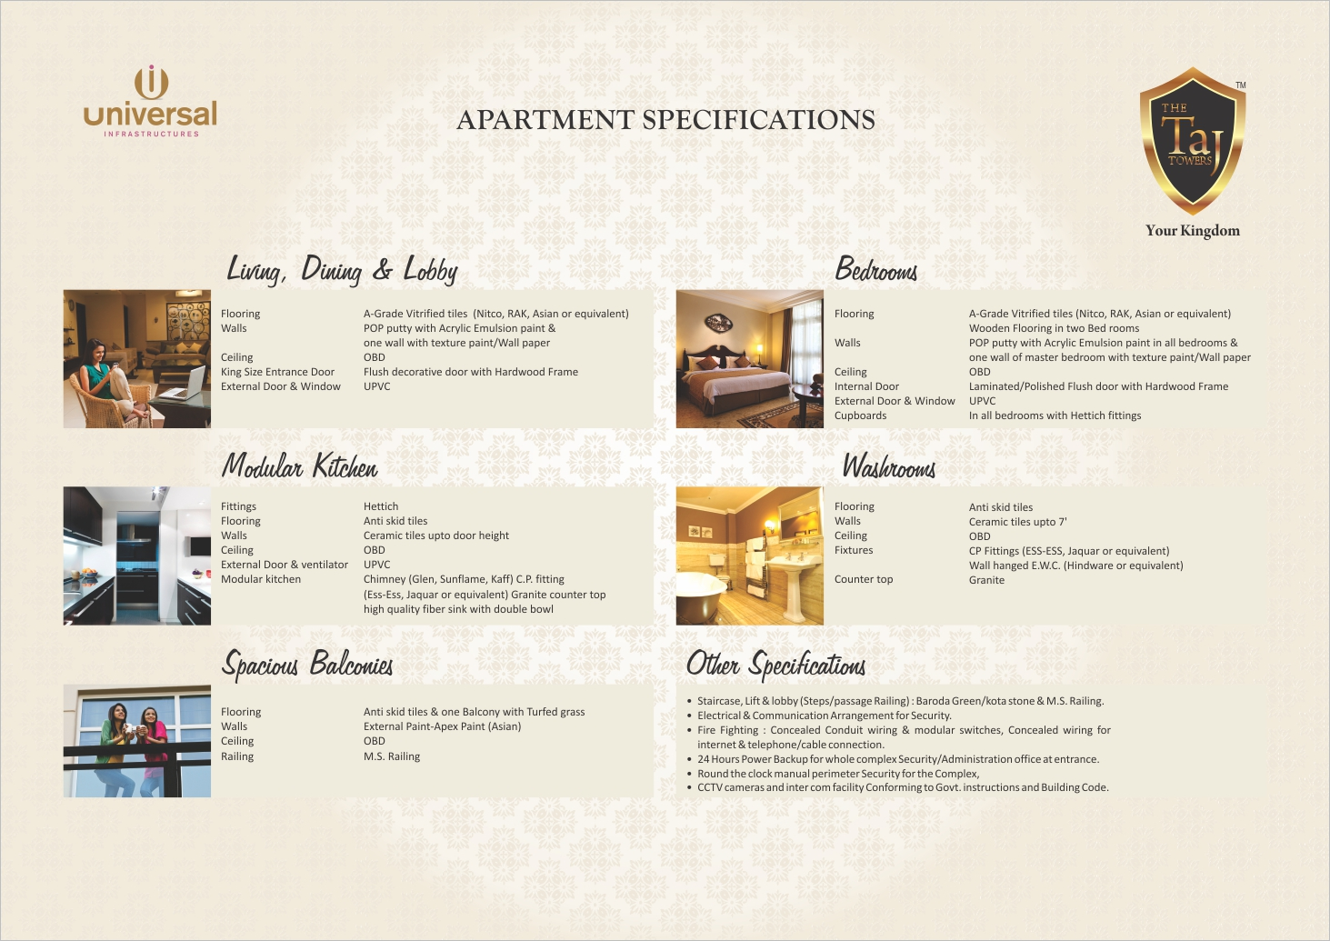


Slide 27
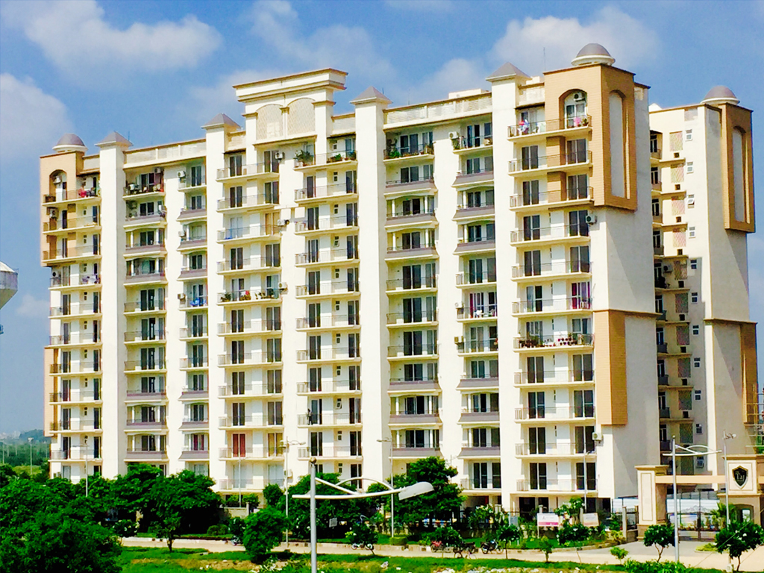

Slide 28
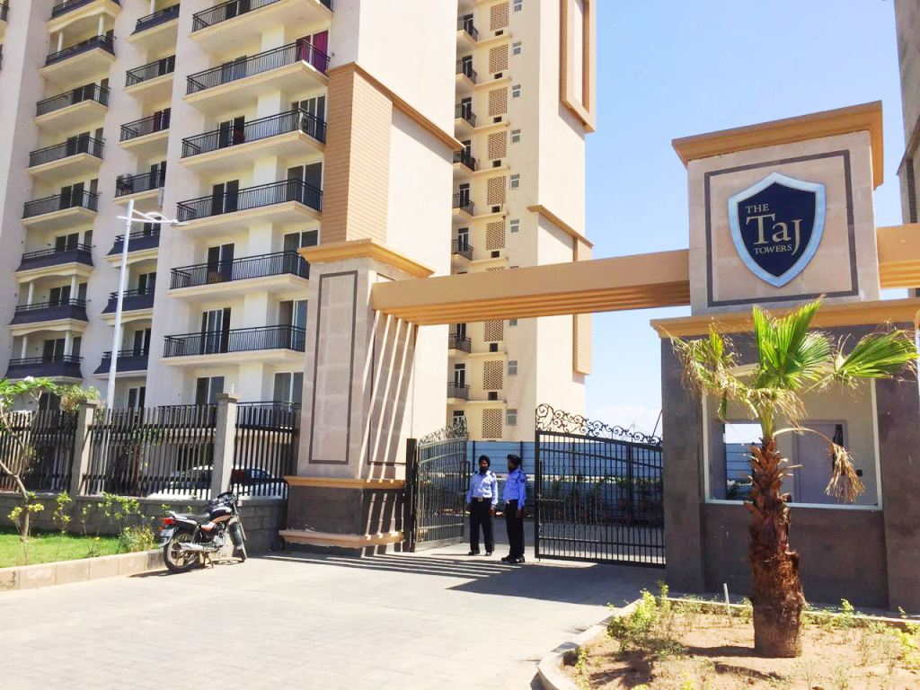

Slide 29
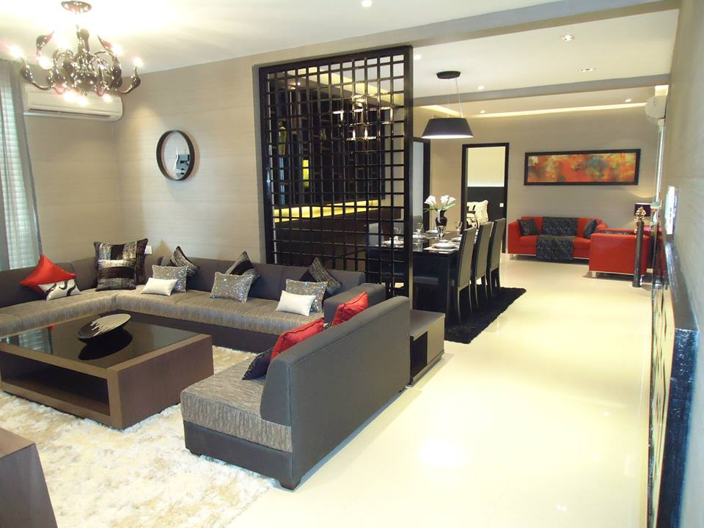

Slide 30
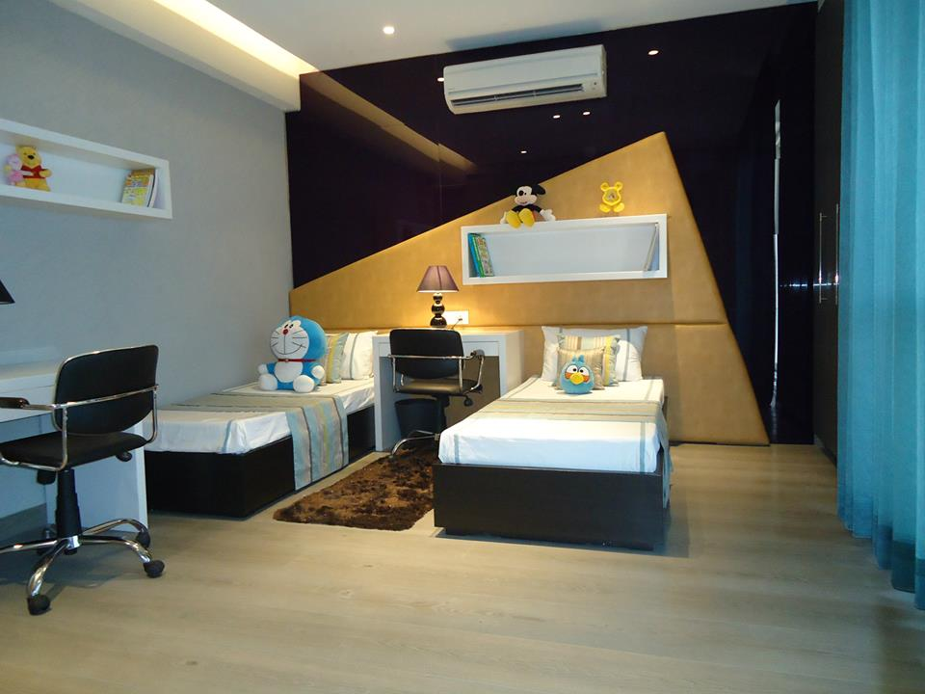

Slide 31
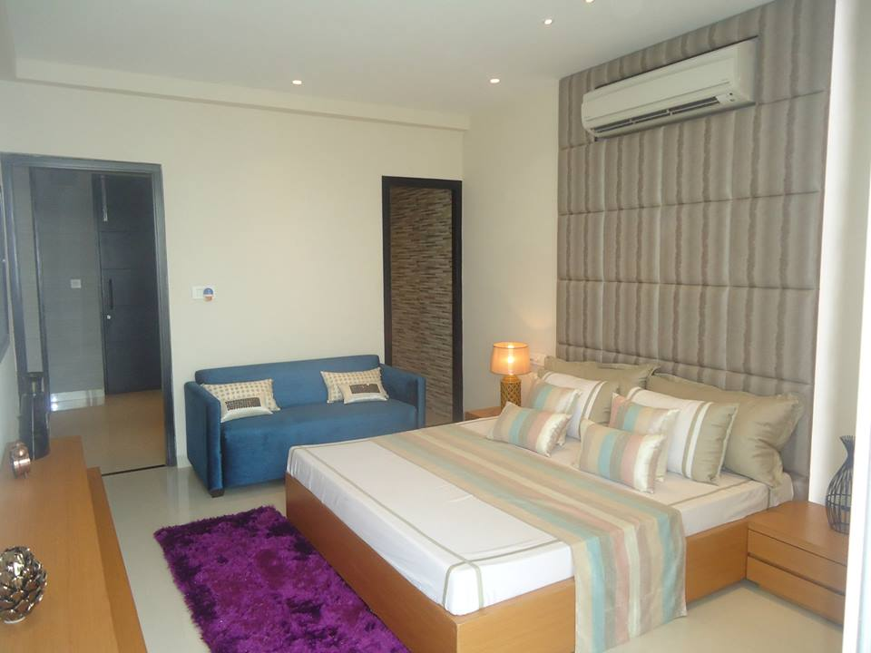

Slide 32
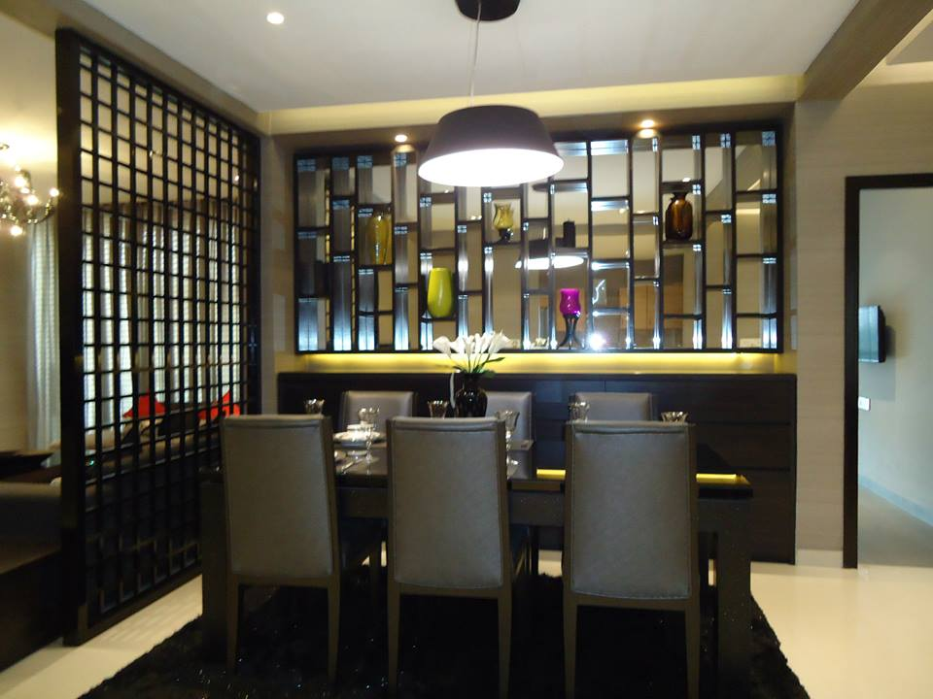

Slide 33
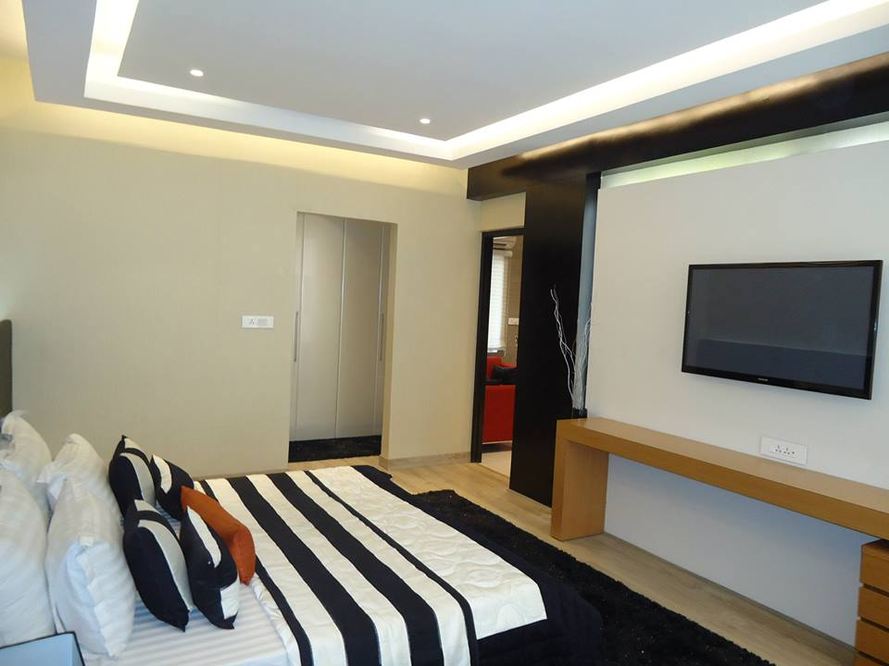

Slide 34


Slide 35
Plotting & Floors
We have the Biggest Government Approved Township in Peermuchhalla, adjoining Sector 20, Panchkula by the name of THE IMPERIAL GARDEN
It consists of Plots and Independent Floors

Slide 36
Flats & Cottages
We have Flats and Cottages Project in Kasauli, Himachal Pradesh, India
Hotel in Kasauli

Slide 37
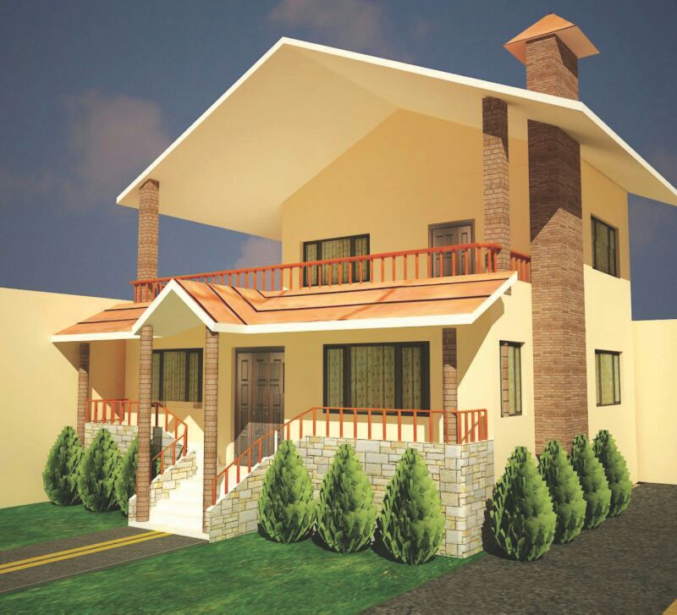

Slide 38
4. HOTELS
We have a two Hotels in and around Kasauli in India:
Hotel Tribe Village, Kumarhatti, India
Hotel Kasauli Greens (undergoing construction) at Kasauli, Himachal Pradesh, India

Slide 39
Thanks a lot!

